Slide 1
Business Systems Intelligence
Lecture 1
Module Overview & Introduction

Slide 2
Contact the Lecturer
Dr. Diana Carvalho e Ferreira
Email: diana.ferreira@dit.ie
Office: KE-G-026
Ext.: 2800

Slide 3
Acknowledgements
Many thanks to Brendan Tierney, who originally developed the module.

Slide 4
Online Resources
Webcourses: CMPU4013-A: Business Systems Intelligence
Self enrolment
http://www.dit.ie/lttc/webcourseslogin/student/

Slide 5
Module Description
Business systems intelligence is an area of increasing importance and interest to organisations involved in knowledge management.
Technologies such as data warehousing and data mining offer huge potential in the creation of new knowledge products and services and the enhancement of existing products and services.

Slide 6
Module Description
The module builds on the student’s previous experiences of working with databases, knowledge tools, techniques and data analysis.
This module covers topics in business systems intelligence relating to the formulation of data and business models for understanding data, construction of data warehouses and the application of data mining techniques.

Slide 7
Module Aims
The aim of this module is to study and practice advanced data modelling techniques and to understand and practice techniques of data warehousing and data mining in the context of business systems.

Slide 8
Learning Outcomes
On completion of this module, the successful learner will be able to:
Discuss how to build a business data model.
Build a dimensional data model.
Discuss the role of data warehousing and data mining in an organisation.
Analyse and evaluate the suitability of different data warehouse architectures.
Develop dimensional models for a data warehouse.

Slide 9
Learning Outcomes
Analyse and evaluate the issues involved in extracting and loading data into a data warehouse.
Discuss the suitability of different data mining techniques.
Identify the requirements of developing a model for data mining.
Perform data mining techniques.
Discuss and evaluate the outcomes from a data mining process.

Slide 10
Module Content
Business Data Modelling
Data, Information, Knowledge
Modelling an activity
Framing a business model
Developing a model
Deploying a model

Slide 11
Module Content
Data Warehousing
Introduction to data warehousing
Characteristics of a data warehouse and how it differs to operational DBs etc.
Extracting and loading data into a data warehouse
Dimensional modelling
Data aggregation

Slide 12
Module Content
Data Mining
Introduction to data mining and applications of data mining
Data mining lifecycles
Data preparation
Data association techniques
Data classification techniques
Data clustering techniques
Data visualisation
Data evaluation

Slide 13
Module Assessment
End of semester written Exam - 70%
Continuous Assessment - 30%
1 Assignment worth 10% - week 5
1 lab test worth 10% - week 8
1 lab test worth 10% - week 10

Slide 14
Reading Material
Kimball & Ross, 2013, The Data Warehouse Toolkit: The Definitive Guide to Dimensional Modeling (Third Edition)
e-book at: http://filepi.com/i/5O8BiuC
WileyHan & Kamber, 2001, Data Mining: Concepts and Techniques, Morgan Kaufmann.
Inmon, 2005, Building the Data Warehouse, Hungry Minds.
Michael J. A. Berry, Gordon Linoff, 1997,Data Mining Techniques: For Marketing, Sales, and Customer Support, Wiley.
Richard J. Roiger, Michael Gaetz, 2002, Data mining : a tutorial-based primer, Addison Wesley.
Olivia Parr Rud, 2000, Data mining cookbook : modeling data for marketing, risk and customer relationship management, Wiley.

Slide 15
Web references, journals and other
Oracle Technology Network, http://www.Otn.oracle.com
Database Trends and Applications website, http://www.dbta.com/index.html
Data Mining & Knowledge Discovery, http://www.kdnuggets.com
Kimball, 1997, Dimensional Modelling Manifesto, DBMS Magazine
Fayyad, 1996, From Data Mining to Knowledge Discovery in Data, AI Magazine
DBMS magazine, http://www.ienterprise.com
DMReview, www.dmreview.com

Slide 16
Questions?

Slide 17
Introduction

Slide 18
Outline
Motivation: Examples
What is business systems intelligence?
Motivation: Why business systems intelligence?
BI systems

Slide 19
A little bit of motivation

Slide 20

Example 1: Telecommunications
Huge amount of data is collected daily:
Transactional data (about each phone call)
Data on mobile phones, house based phones, Internet, etc.
Other customer data (billing, personal information, etc.)
Additional data (network load, faults, etc.)

Slide 21
Example 1: Telecommunications
Questions:
Which customer groups are highly profitable, and which are not?
To which customers should we advertise which kind of special offers?
What kind of call rates would increase profits without losing good customers?
How do customer profiles change over time?
Fraud detection (stolen phones or phone cards)
Can we identify immanent customer churn?

Slide 22

Example 2: Health
Data collected about many different aspects of the health system
Personal health records (at GPs, specialists, etc.)
Hospital data (e.g. admission data, midwives data, surgery data)
Billing information (VHI, etc.)

Slide 23
Example 2: Health
Questions:
Are doctors following the procedures (e.g. prescription of medication)?
Adverse drug reactions (analysis of different data collections to find correlations)
Are people committing fraud?
Correlations between social and environmental issues and people's health?

Slide 24

Example 3: Finance
Data is collected on just about every financial transaction we perform
Credit card transactions
Direct debits
Loan applications
Retail financing deals

Slide 25

Example 3: Finance
Questions:
Is a customer likely to repay their loans?
Is a credit card transaction fraudulent?
Will a customer respond to special offers?
Can we identify groups of similar customers?

Slide 26
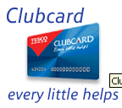
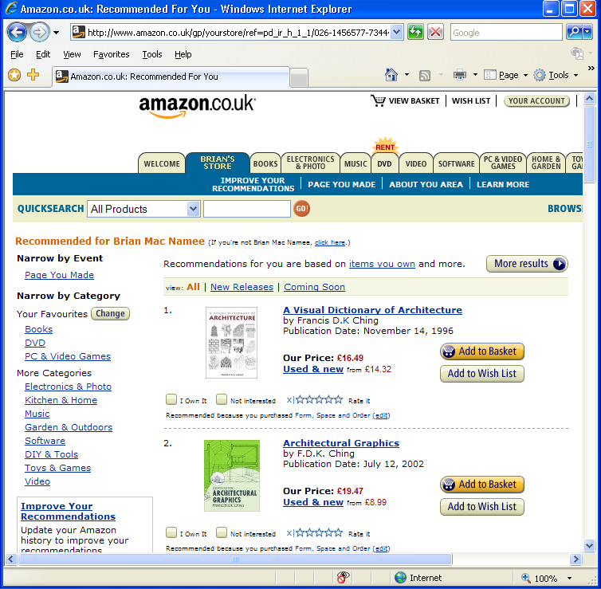
Example 4: Retail
Every time you buy items using a loyalty card, a record is kept
On-line the situation is even more extreme – every time you even look at an item a record is kept
There is a lot of
information out there
about what you like!

Slide 27
Example 4: Retail
Questions:
What items are you likely to buy in the future?
In particular what combinations are you likely to buy?
How can we re-arrange our store to make you impulse buy?
What kind of special offers would you most likely respond to?
Which other customers are you most closely related to?
What kind of ads can we display to you while you browse?

Slide 28











A lot of other examples
Data is a Business Asset!

Slide 29
Introducing...
Business Intelligence

Slide 30
Based on the examples we have looked at, what is BI to you?

Slide 31
Well, BI is a lot of things
Optimization
What’s the best that can happen?
Predictive modelling
What will happen next?
Analytics
Forecasting/extrapolation
What if these trends continue?
Statistical analysis
Why is this happening?
Competitive advantage
Alerts
What actions are needed?
Query/drill down
Where exactly is the problem?
Access & reporting
Ad hoc reports
How many, how often, where?
Standard reports
What happened?
Degree of intelligence

Slide 32
What is it then?
“Business intelligence uses knowledge management, data warehouse[ing], data mining and business analysis to identify, track and improve key processes and data, as well as identify and monitor trends in corporate, competitor and market performance.”
-bettermanagement.com

Slide 33
Are there other terms?
Data Fishing, Data Dredging (1960…):
Used by statisticians
Knowledge Discovery in Databases (1989…):
Used by AI, Machine Learning Community
Data Mining, Business Intelligence (1990…):
Business management term
Also data archaeology, information harvesting, information discovery, knowledge extraction, data/pattern analysis, etc.

Slide 34
We will basically consider business systems intelligence to be:
Data Warehousing + Data Mining + Business Sense
Warning: A lot of these terms are used interchangeably

Slide 35

What is a Data Warehouse?
Defined in many different ways, but not rigorously
A decision support database that is maintained separately from the organization’s operational database
Support information processing by providing a solid platform of consolidated, historical data for analysis
“A data warehouse is a subject-oriented, integrated, time-variant, and non-volatile collection of data in support of management’s decision-making process”
—Bill Inmon

Slide 36
What is Data Mining?
Data mining (knowledge discovery from data)
Extraction of interesting (non-trivial, implicit, previously unknown and potentially useful) patterns or knowledge from a huge amount of data

Slide 37
Data Mining: on what kinds of data?
Relational database
Data warehouse
Transactional database
Advanced database and information repository
Spatial and temporal data
Time-series data
Stream data
Multimedia database
Text databases

Slide 38
Data Mining Functionalities
Concept description
Generalize, summarize, and contrast data characteristics
Association (correlation and causality)
Classification and Prediction
Construct models that describe and distinguish classes or concepts for future prediction
Predict some unknown or missing numerical values

Slide 39
Data Mining Functionalities
Cluster analysis
Class label is unknown: Group data to form new classes, i.e., cluster data points to find distribution patterns
Outlier analysis
Outlier: a data object that does not comply with the general behavior of the data
Noise or exception? No! useful in fraud detection and rare event analysis
Trend and evolution analysis
Trend and deviation: regression analysis
Other pattern-directed or statistical analyses

Slide 40
BSI is Multidisciplinary
Statistics
Pattern
Recognition
Neurocomputing
Machine
Learning
Data Mining
AI
Databases
BSI

Slide 41
The Many Applications

Slide 42
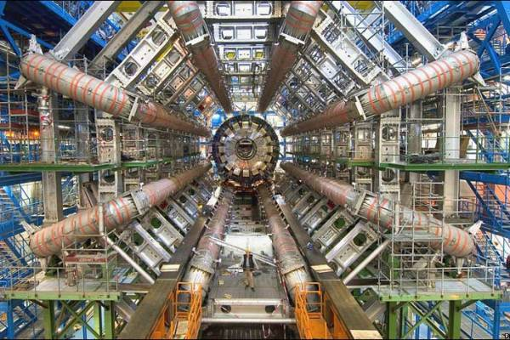
Drowning in Data
The Large Hadron Collider at CERN was turned on
The LHC generates
1GB of data per second,
15 PB per year.
Data explosion problem: automated data collection tools and cheap storage leads to huge amounts of data accumulated
We are drowning in data, but starving for knowledge!

Slide 43
Necessity is the mother of invention
Solution: Data warehousing and data mining
Data warehousing and online analytical processing
Mining interesting knowledge (rules, regularities, patterns, constraints) from data in large databases

Slide 44
Drowning in data, starving for knowledge
DATA
KNOWLEDGE

Slide 45
Business Intelligence Processes

Slide 46
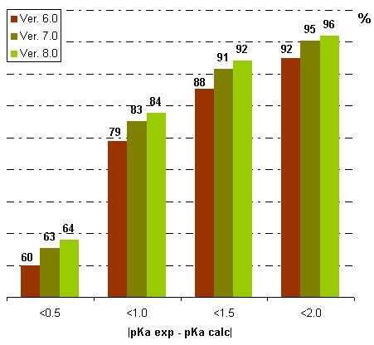
The knowledge discovery process
Knowledge
Evaluation and Presentation
Data Mining
Selection and Transformation
Data Warehouse
Cleaning and Integration
Databases

Slide 47
Data Mining & Business Intelligence
Increasing potential
to support
business decisions
Making
Decisions
End User
Data Presentation
Business
Analyst
Visualization Techniques
Data Mining
Data
Analyst
Information Discovery
Data Exploration
Statistical Analysis, Querying and Reporting
Data Warehouses / Data Marts
OLAP, MDA
DBA
Data Sources
Paper, Files, Information Providers, Database Systems, OLTP
Notes:
multidimensional analysis (MDA)
online analytical processing (OLAP)
Online transactional processing (OLTP)

Slide 48
Architecture of a typical data mining system
Graphical User Interface
Pattern Evaluation
Knowledge Base
Data Mining Engine
Database Or Data Warehouse Server
Data Cleaning & Integration
Filtering
Data Warehouse
Databases

Slide 49
Major issues in BI
Data mining methodology
Mining different kinds of knowledge from diverse data types, e.g., bio, stream, Web
Performance: efficiency, effectiveness, and scalability
Pattern evaluation: the interestingness problem
Incorporation of background knowledge
Handling noise and incomplete data
Parallel, distributed and incremental mining methods
Integration of the discovered knowledge with existing one: knowledge fusion

Slide 50
Major Issues In BI
User interaction
Query languages and ad-hoc mining
Expression and visualization of resultant knowledge
Interactive mining of knowledge at multiple levels of abstraction
Applications and social impacts
Domain-specific data mining & invisible data mining
Protection of data security, integrity, and privacy

Slide 51
Some case studies

Slide 52
Example 1: Telecommunications
Case study:
in the Czech Republic use SAS data mining software for two jobs:
Determining if late payers should be cut off
Determining which customers will respond to special offers
“We can’t do manual credit checks on each residential customer, so this saves a lot of time. We know what customers need to make deposits and who isn’t a credit risk, so they don’t need to have their service cut off if their payment is a few days late. It improves customer satisfaction.”
—Pavel Vlasaný, Head of Credit Risk and Collection

Slide 53

Example 2: Health
Case study:
has developed a health management solution that predicts which Aetna members will incur the highest healthcare costs in the upcoming year
Steps can then be taken to improve care – and, so, reduce costs – for those members
“SAS allows us to make more accurate predictions so that we can present that information to the case managers in a very simple, user-friendly fashion.”
- Howard Underwood, Head of Informatics and Quality Metrics

Slide 54

Example 3: Finance
Case study:
Laurentian Bank of Canada deal with requests through recreational vehicle dealers from consumers wanting to borrow money to purchase vehicles such as snowmobiles, ATVs, boats, RVs and motorcycles.
They use SAS online scoring models to determine which customers will default on loans
“The quality and efficiency of the loan appraisal process has definitely improved.”
-Sylvain Fortier , Senior Manager for Retail Risk Management, Laurentian Bank

Slide 55

Example 4: Retail
Case study:
use data mining to predict the behaviour of their customers
While they don’t use SAS software live on their web site they use it to explore techniques they are interested in deploying
“We work hard to refine our technology, which allows us to make recommendations that make shopping more convenient and enjoyable. SAS helps Amazon.com analyze the results of our ongoing efforts to improve personalization”
-Diane N. Lye Amazon.com's Snr. Manager for Worldwide Data Mining

Slide 56
Steps of a BI process
Learning the application domain
Relevant prior knowledge and goals of application
Creating a target data set: data selection
Data cleaning and preprocessing
May take 60% of effort!
Data warehousing
Data reduction and transformation
Find useful features, dimensionality/variable reduction
Choosing functions of data mining
Classification, regression, clustering, etc.

Slide 57
Steps Of A BI Process
Choosing the mining algorithm(s)
Data mining: search for patterns of interest
Pattern evaluation and knowledge presentation
Visualization, transformation, removing redundant patterns, etc.
Use of discovered knowledge

Slide 58
Evolution of Database Technology
1960s:
Data collection, database creation, network DBMS
1970s:
Relational data model, relational DBMS implementation
1980s:
RDBMS, advanced data models (extended-relational, etc.)
Application-oriented DBMS (spatial, scientific, engineering, etc.)
Notes:
Extending the query language allows for the integration of well-understood query optimization techniques. With the ERDBMSs, programmers are able to write functions in conventional languages as well as in SQL. These DBMSs have been extended to handle complex data types, which include user defined abstract data types.

Slide 59
Evolution of Database Technology
1990s:
Data mining, data warehousing, multimedia databases
2000s
Stream data management and mining
Data mining with a variety of applications
Web technology and global information systems
2010s
Cloud computing
Hadoop – Data by the Petabyte (BIG DATA)
NoSQL, MongoDB…

Slide 60
Why BI? Potential Applications
Data analysis and decision support
Market analysis and management
Risk analysis and management
Fraud detection and detection of unusual patterns
Other applications of Data Mining
Text mining (email, documents) and Web mining
Data Stream mining
DNA and bio-data analysis
Notes:
Examples of data streams include computer network traffic, phone conversations, ATM transactions, web searches, and sensor data.

Slide 61
Market Analysis and Management
Where does the data come from?
Credit card transactions, loyalty cards, discount coupons, customer complaint calls, etc
Target marketing
Find clusters of “model” customers who share the same characteristics
Determine customer purchasing patterns over time
Cross-market analysis
Associations/co-relations between product sales, & prediction based on such association

Slide 62
Market Analysis and Management
Customer profiling
What types of customers buy what products (clustering or classification)
Customer requirement analysis
Identifying the best products for different customers
Predict what factors will attract new customers
Provision of summary information
Multidimensional summary reports
Statistical summary information (data central tendency and variation)

Slide 63
Corporate Analysis & Risk Management
Finance planning and asset evaluation
Cash flow analysis and prediction
Contingent claim analysis to evaluate assets
Cross-sectional and time series analysis (financial-ratio, trend analysis, etc.)
Resource planning
Summarize and compare the resources and spending
Competition
Monitor competitors and market directions
Group customers into classes and a class-based pricing procedure
Set pricing strategy in a highly competitive market

Slide 64
Fraud Detection & Mining Unusual Patterns
Applications: Health care, retail, credit card service, telecommunications
Auto insurance: ring of collisions
Money laundering: suspicious monetary transactions
Medical insurance
Professional patients, ring of doctors, and ring of references
Unnecessary or correlated screening tests
Telecommunications: phone-call fraud
Phone call model: destination of the call, duration, time of day or week. Analyze patterns that deviate from an expected norm
Retail industry
Analysts estimate that 38% of retail shrink is due to dishonest employees
Anti-terrorism
Approaches: Clustering, model construction, outlier analysis, etc.

Slide 65
Other Applications of Data Mining
Sports
IBM Advanced Scout analyzed NBA game statistics (shots blocked, assists, and fouls) to gain competitive advantage for New York Knicks and Miami Heat
Astronomy
JPL and the Palomar Observatory discovered 22 quasars with the help of data mining
Internet Web Surf-Aid
IBM Surf-Aid applies data mining algorithms to Web access logs for market-related pages to discover customer preference and behavior to help analyzing effectiveness of Web marketing, improving Web site organization, etc.

Slide 66
Closing Notes

Slide 67
Summary
Business Systems Intelligence: Data Warehousing + Data Mining + Business Sense
We are drowning in data, but starving for knowledge
A BI process includes data cleaning, data integration, data selection, transformation, data mining, pattern evaluation, and knowledge presentation

Slide 68
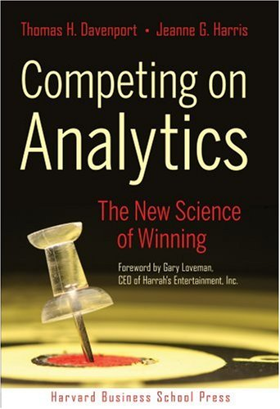

Books
“Competing On Analytics: The New Science of Winning”, Thomas H Davenport & Jeanne G Harris, Harvard Business School Press, 2007
“Super Crunchers: Why Thinking-by-Numbers Is the New Way to Be Smart”, Ian Ayres, Bantam Books, 2007

Slide 69
Where to find more?
Data mining and KDD (SIGKDD: CDROM)
Conferences: ACM-SIGKDD, IEEE-ICDM, SIAM-DM, PKDD, PAKDD, etc.
Journal: Data Mining and Knowledge Discovery, KDD Explorations
KDnuggets: www.kdnuggets.com
Database systems (SIGMOD: CD ROM)
Conferences: ACM-SIGMOD, ACM-PODS, VLDB, IEEE-ICDE, EDBT, ICDT, DASFAA
Journals: ACM-TODS, IEEE-TKDE, JIIS, J. ACM, etc.
AI & Machine Learning
Conferences: Machine learning (ML), AAAI, IJCAI, COLT (Learning Theory), etc.
Journals: Machine Learning, Artificial Intelligence, etc.
Statistics
Conferences: Joint Stat. Meeting, etc.
Journals: Annals of statistics, etc.
Visualization
Conference proceedings: CHI, ACM-SIGGraph, etc.
Journals: IEEE Trans. visualization and computer graphics, etc.

Slide 70
Questions?

